Slide 1
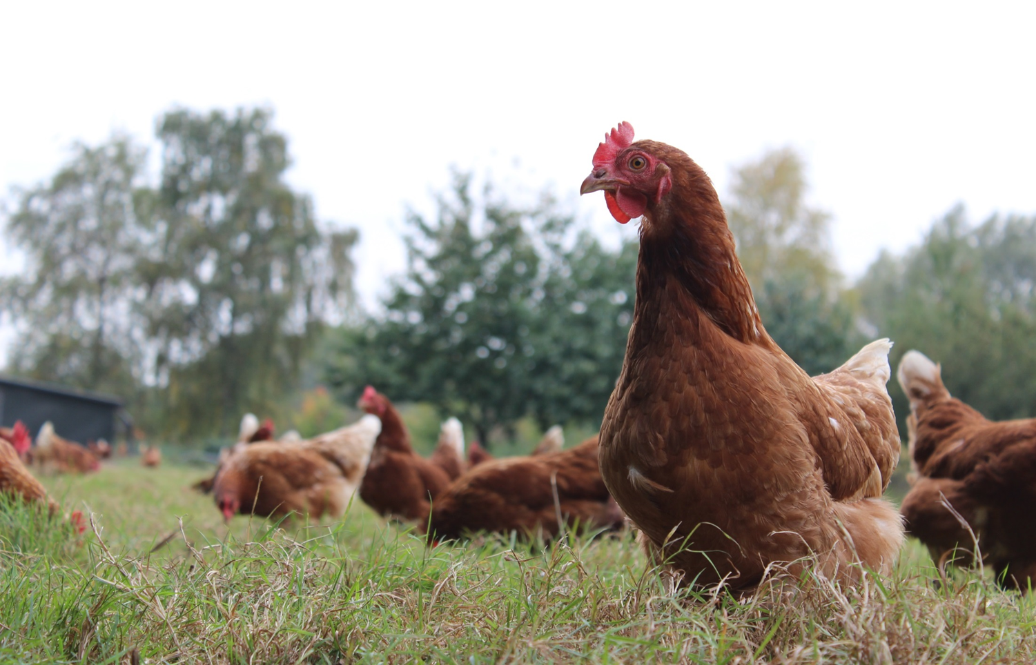
Towards a good life for farm animals
Leveraging positive welfare innovation
Notes:
Good afternoon, my name is Jessica Stokes, and I work at Bristol University in the UK, hence I cannot be with you in real time or in person! I would just like to start by acknowledging my colleagues Professor David Main, Siobhan Mullan and Jo Edgar who developed the original idea which I am going to be talking to you about, and 2 other key collaborators at the Scottish Rural Agricultural Colleague, Professor Cathy Dwyer and Marie Haskell. I am happy to answer any questions you may have via email, which Jen will coordinate.
I want to talk to you about some work we have been doing with laying hen, sheep and dairy farmers.
So we know society values animals quality of life and consumer awareness, willingness to pay and demand for higher welfare products is increasing. Many consumers want to buy products from happy animals that have had positive welfare experiences, towards a good life, and high animal welfare assurance schemes want to demonstrate they can provide these products. A number of approaches to providing this evidence are developing. Measuring pleasurable behaviours such as play, observing body language and emotion like qualitative behavioural assessment, and more recently, grading resources which can provide positive welfare opportunities.

Slide 2
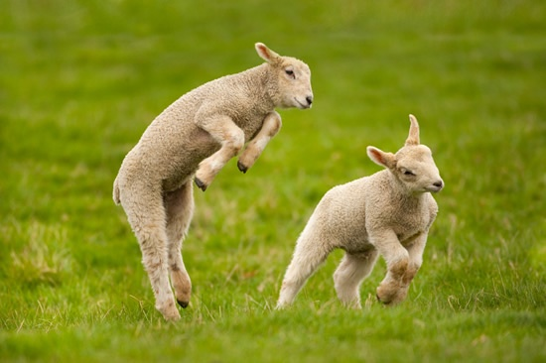
‘‘Play is probably quite far down their priority list. As soon as it’s a really sunny day and they are full up and satisfied, they will play. It shows maximal environmental comfort.’’
‘’We now use play to indicate wellbeing. A sudden reduction in play behaviour would alert us that something wasn’t right.’’
FAWC : Freedom FAWC : Opportunity
Notes:
However, despite there validity, to our knowledge none of these approaches have been applied formally on farm to monitor positive welfare. During the AssureWel project, which developed welfare outcome assessment for UK farm assurance schemes, we tried to do this, but none of the measures currently available to us were feasible or practical enough. Observing behaviour directly takes time and does not fit into the space of a yearly visit. At any rate, this would tell us very little about the accumulative positive and negative experiences which make up the quality of the animals life.
Take play for example. Play releases happy hormones, is a means of learning appropriate social behaviour, bonding and making friends. Animals do not play in discomfort, hungry, thirst, in a restricted environment, when unhealthy or in pain, but when all needs are satisfied. Play is pleasurable, and therefore a great candidate for positive welfare. But play is rare seen. As one sheep farmer put it:
Play is probably quite far down their priority list. As soon as it’s a really sunny day and they have got a lot of grass in front of them, but they are full up and satisfied, they will play. It shows maximal environmental comfort.
So unless you are a farmer or caregiver watching animals for a significant part or intermittently throughout the day, will you see play? Probably not. Unless we use automated systems, it can only really be feasibly and practically applied by farmers. Automatic recording may work for some, but it would takes the fun and objective out of observing positive welfare experiences for others. As another sheep farmer said to me recently:
We now use play to indicate wellbeing. A sudden reduction in play behaviour would alert us that something wasn’t right. In the past it was like, oh they are playing, they must be doing really well, but now having seen more play, or having become more aware of more play by watching them more, I’m now thinking, why am I not seeing as much play as usual?
Spending time observing play in his animals has increased his awareness of positive welfare experiences. He is now using play as a tool to monitor his sheep's wellbeing. So first and foremost I would say, supporting farmers to start observe the behavioural repertoire of their animals is a key tool to raising awareness and can evoke farmer led innovation.
So where does that leave animal welfare scientists who want to develop measures of positive welfare, and government and industry who want to demonstrate it? We could capture and share what farmers do. But in the absence of time and resource to observe behavioural outcomes, what other options do we have?

Slide 3
Quality of Life
Opportunity
A Good Life
Positive Welfare
Comfort
Pleasure
Interest
Confidence
A Healthy Life
A Life Worth Living
A Life not worth living
Restricted Normal Behaviour
Negative Welfare
Hunger and Thirst
Fear and Distress
Pain, Injury and Disease
Discomfort
Freedom
Reference: Edgar JL, Mullan SM, Pritchard JC, McFarlane UJC and Main DCJ 2013. Towards a ‘good life’ for farm animals: development of a resource tier framework to achieve positive welfare for laying hens. Animal 3, 1-10 http://www.mdpi.com/2076-2615/3/3/584
Notes:
In 2009, the Farm Animal Welfare Council, expert advisory panel to UK Government proposed that the quality of an animal’s life is classified as: a life not worth living (below legal standards) a life worth living (current legal standard) or a good life (way above and beyond legal standard). Here they suggested that positive welfare could be measured by the provision of opportunities or resources that an animal does not need but are valued by the animal.
So one practical example of this is going from just feeding wholegrain and grit to laying hens, to providing an interesting and varied choice of forage substrates that chickens value, such as clover and chicory in the grass, spent veg in hanging nets, or roughage like alfalfa in the scratch area.
As you can see these good life opportunities and like the 5 domains, and compliment the 5 freedoms, expanding and enhancing our definition of welfare to include not only the reduction of negative welfare, but critically promoting positive welfare, through comfort, pleasure, interest, and confidence. This is the essence of what you are all here today to discuss.
At the heart of this concept is that animals show individual preferences, and value choice, and the more valued resources you provide, the more positive welfare opportunities.
In response, Bristol University consolidated the evidence base on how to achieve good life opportunities in laying hens and published a paper on this in 2013, the reference for which you can see at the bottom of the slide. As part of the AssureWel project, I went out and piloted this framework with 50 free range and/or organic farmers in the UK, critically, finding that a significant proportion of these farmers were already providing a lot of these resources to some extent.

Slide 4
Opportunities
Resources
Positive genetic selection
{
Healthy Life
Managing daily welfare
Dustbathing choices
Enriched outdoor environment
{
Interest
Enriched indoor environment
{
Positive social experiences
Confidence
Nesting choices
+
++
Positive handler experiences
+++
{
Food choices
Pleasure
Cognition enrichment
Environmental choices
{
Comfort
Thermal choices
Physical choices
Number of flocks
Notes:
So here is a graph showing how farmers were already providing resources for these good life opportunities. I haven’t got time to go through the detail here but I do recommend you read the paper. As you can see, there are 3 levels of increasing positive welfare which are set above UK law and welfare code: Welfare + indicated by the black boxes, Welfare ++ indicated by the grey boxes and Welfare +++ indicated by the white boxes. This aims to set a benchmark and barometer for what a good life can look like.
As you can see the initial pilot found a range of performance. For example, cognitive enrichment was only present on one out of five farms surveyed, however choice of thermal environment was present on 9 out of 10 farms. So this kind of approach could be used to identify areas of excellence and enhancement at a farm, system, scheme or industry level.
The key point I really want to make here is that overall, three out of five of these resources were being provided to some extent already. Although a very small sample, this does suggest some farmers are already providing these kinds of opportunities in these systems for laying hens.

Slide 5
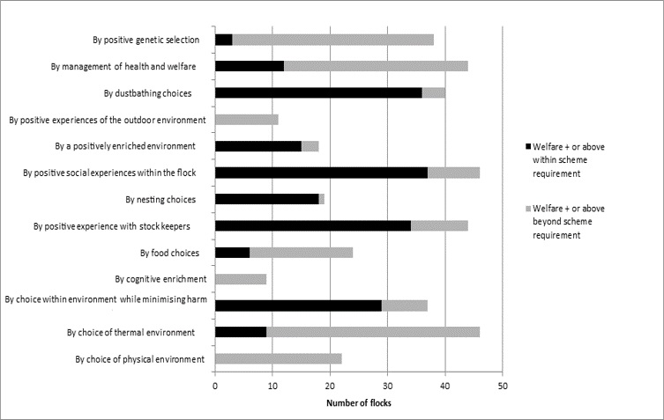
Opportunities
Resources
{
Positive genetic selection
Healthy Life
Managing daily welfare
Dustbathing choices
Enriched outdoor environment
{
Interest
Within scheme requirement
Enriched indoor environment
{
Positive social experiences
Confidence
Nesting choices
Beyond scheme requirement
Positive handler experiences
{
Food choices
Pleasure
Cognition enrichment
{
Environmental choices
Comfort
Thermal choices
Physical choices
Number of flocks
Notes:
And even more interestingly I think, a quarter of these resources were found to be above the market initiative standard requirements. This suggests these positive welfare opportunities are not currently being formally recognised or in fact rewarded. I think this is really important because this is just the kind of evidence base that can be utilised as a communication tool to consumers.
So why are some opportunities on nearly every farm we visited, and others much more infrequent? What is the cost benefit to the farm for delivering each opportunity? We are currently doing some work looking at the prevalence of these resources against the cost of providing them. We want to be in a position to make policy recommendations for a post Brexit welfare stewardship scheme which incentivises positive welfare. For example, where the value to the animal is high, but the cost for providing that opportunity is higher than the market premium gained, government incentives can be used to advance positive welfare as a public good. We would be happy to share the policy briefings on this in due course.

Slide 6
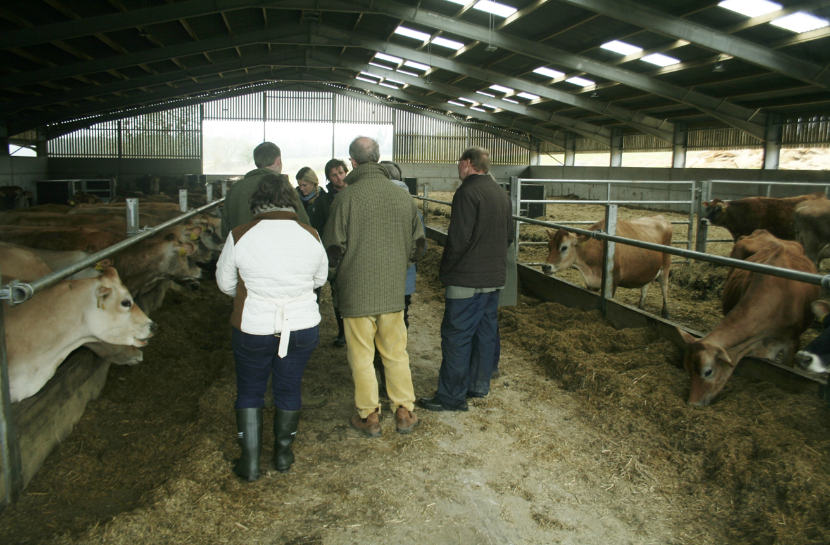
Collaborative development of positive welfare measures with dairy cattle and sheep farmers
Notes:
Rewarding positive welfare is intuitively more motivating than just penalising negative welfare, enriching farmer satisfaction and wellbeing. Ownership and autonomy are key. Farmers are experts who care for animals day in day out. Can we really expect anyone to provide choice and autonomy for animals without giving them the opportunity to define what that looks like, or the flexibility to innovate around how to deliver it?
Funded by the Scottish Government and in collaboration with Scottish Rural Agricultural College, I am currently working collaboratively with groups of dairy and sheep farmers, to find out how they conceptualise positive welfare. Using a discussion group format, over two or three 3 hourly meetings, I have explored and captured their ideas, assimilating them into a framework similar to the laying hen example I mentioned earlier.

Slide 7
‘What is the value of positive welfare? What are the benefits of a good life for your dairy cows?’
1. Animals quality of life
2. Better health and productivity
3. Farmers pride and wellbeing
4. Society and market values positive welfare
5. Ethically right and supported by science
Notes:
I started by asking farmers what they value about positive welfare. First and foremost they want to give their animals the best quality of life, but delivering positive welfare was also seen as integral part of their own pride and wellbeing. The sheep farmers in particular felt strongly that the mental wellbeing of the farmer was inextricable linked to the mental wellbeing of their animals. They felt demonstrating positive welfare was becoming increasingly important to buyers and consumers, and interestingly saw it as a much needed evidence base to engage in more positive dialogue with critics. They saw its value in getting ahead in the market place and welcomed voluntary schemes which provided premiums or incentives for delivering more positive welfare. They also saw delivering the best possible quality of life was both the ethically and scientifically right thing to do.

Slide 8
Comfort by choice of physical environment
Aim: Cows should be able to experience individual preferences for their physical comfort
 | Pre consultation | Post consultation
Welfare + | Deep bedded loose housing and choice to avoid hard surfaces | Plus deep bedded (at least 6 inches) super comfort sand cubicles Plus 10-20% more cubicles than cows
Welfare ++ | Deep bedded loose housing with choice of different lying areas and substrates sometime | Plus rubber matting at feed face, yard and parlour Plus farm monitoring of cow comfort (cameras, activity data, behavioural observations, WOs) Plus continuous adjustment of resources and management to improve comfort where necessary
Welfare +++ | Deep bedded loose housing with choice of different lying areas and substrates at all times | Plus 10-20% more lying space than cows Plus Farm monitoring of cow comfort Plus continuous adjustment of resources and management to improve comfort where necessary
Notes:
Ok, so then I ask how they defined positive welfare? In terms of both current best practice and aspirational. What is a good life for animals? All the ideas were married up next to the relevant good life opportunities and each were discussed in turn to create draft measures the group agreed on.
This slide summarises one example - comfort by choice of physical environment. Farmers added 4 significant practical additions to this opportunity. The inclusive of super comfort cubicles to increase accessibility to all farmers, stipulating a generous amount of lying space to create more choice, the use of rubber matting to improve underfoot comfort, and having a farm specific policy on monitoring the use of resources (by any valid means they liked using cameras, activity meter data, behaviour observations, outcome scoring) to adjust management to improve comfort.

Slide 9
Notes:
I am just in the process of analysing and writing this work up, including a policy briefing around the benefits of the process itself. As a result of engaging in this process, some of the farmers have taken the ideas back to their farms and discussion groups to trial new practices. So this kind of approach has lots of potential applications. A discussion group tool, ideas to base farmer led innovation around, an industry benchmark for positive welfare, or ideas for government or market incentives.
The farmers I have worked with welcome the focus on positive welfare, and want an approach which is accessible for all but is flexible enough to allow for differentiation. Where change requires substantial investment they require government or market incentives. They would like an approach which is led by sharing working best practice and on farm innovation.
In the longer run I think our job as animal welfare scientists is to work along side farmers and industry to develop ways of measuring the desired outcomes and impact, which will further validates the experiences and resources animals most want us to provide.
Thank you for your attention. I hope this work can inspire todays discussions! I look forward to hearing the outcomes.

